Slide 1
Arizona Independent Redistricting Commission Compactness Measures

Slide 2
Why is Compactness important

Slide 3
Measurements of Compactness
Perimeter Test
The Perimeter test computes the sum of the perimeters of all the districts. The Perimeter test computes one number for the whole plan.
If you are comparing several plans, the plan with the smallest total perimeter is the most compact.
3

Slide 4
Measurements of Compactness
Reock Test
CD | Score
1 | .64
2 | .55
3 | .44
4 | .48
5 | .43
6 | .47
7 | .48
8 | .43
9 | .60
The Reock test is an area-based measure that compares each district to a circle, which is considered to be the most compact shape possible.
For each district, the test computes the ratio of the area of the district to the area of the minimum enclosing circle for the district.
The measure is always between 0 and 1, with 1 being the most compact.
4

Slide 5
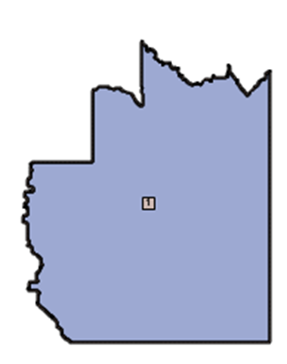
Measurements of Compactness
Reock Test
Grid CD 1 is the best
under the Reock Test
5

Slide 6
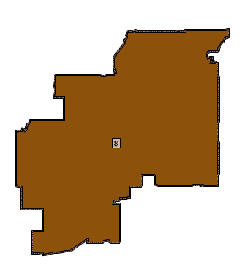
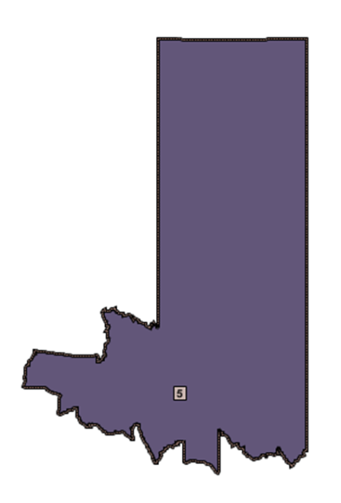
Measurements of Compactness
Reock Test
Grid CDs 5 & 8 are the worst
under the Reock Test
6

Slide 7
Measurements of Compactness
CD | Score
1 | .44
2 | .30
3 | .37
4 | .40
5 | .28
6 | .42
7 | .49
8 | .39
9 | .59
Polsby-Popper Test
The Polsby-Popper test computes the ratio of the district area to the area of a circle with the same perimeter: 4pArea/(Perimeter²).
The measure is always between 0 and 1, with 1 being the most compact.
The Polsby-Popper test computes one number for each district and the minimum, maximum, mean and standard deviation for the plan.
7

Slide 8
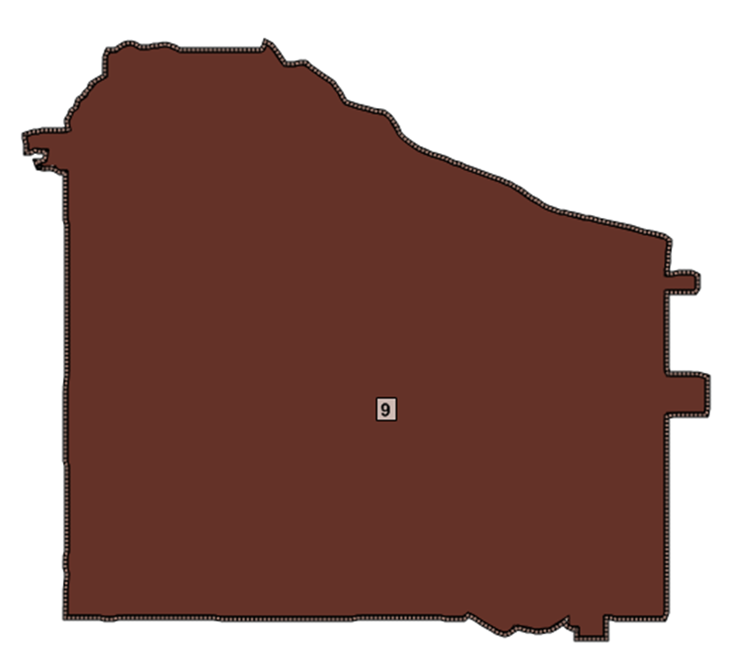
Measurements of Compactness
Polsby-Popper Test
Grid CD 9 is the best
under the Polsby-Popper Test
8

Slide 9
Measurements of Compactness
Polsby-Popper Test
Grid CD 5 is the worst
under the Polsby-Popper Test
9

Slide 10
Measurements of Compactness
Population Polygon Test
CD | Score
1 | .88
2 | .50
3 | .37
4 | .50
5 | .40
6 | .94
7 | .82
8 | .80
9 | .93
Computes the ratio of the district population to the approximate population of the convex hull of the district (minimum convex polygon which completely contains the district).
The measure is always between 0 and 1, with 1 being the most compact.
The Population Polygon test computes one number for each district and the minimum, maximum, mean and standard deviation for the plan.
10

Slide 11
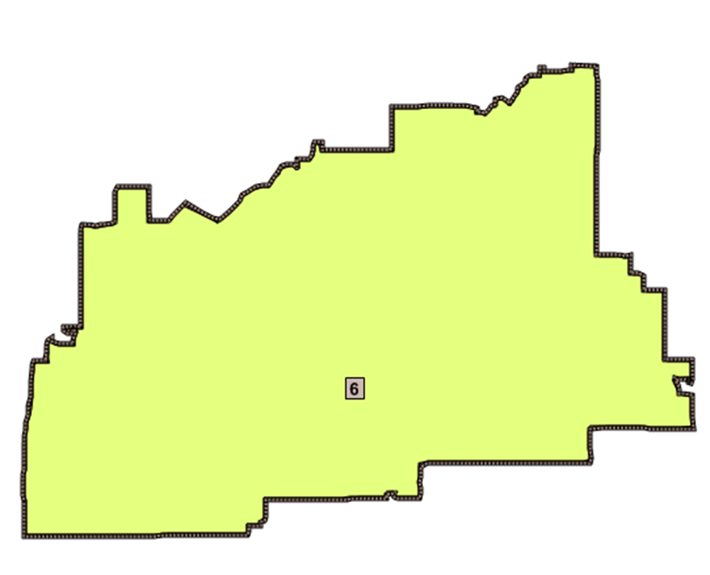
Measurements of Compactness
Population Polygon Test
Grid CD 6 is the best
under the Population Polygon Test
11

Slide 12
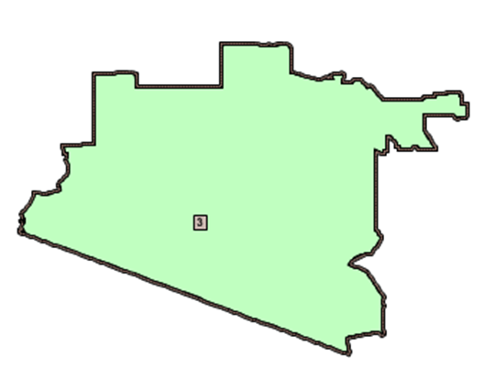
Measurements of Compactness
Population Polygon Test
Grid CD 3 is the worst
under the Population Polygon Test
12

Slide 13
Measurements of Compactness
Population Circle Test
CD | Score
1 | .63
2 | .41
3 | .17
4 | .15
5 | .27
6 | .64
7 | .45
8 | .48
9 | .64
The population circle test computes the ratio of the district population to the approximate population of the minimum enclosing circle of the district.
The population of the circle is approximated by overlaying it with a base layer, such as Census Blocks. The measure is always between 0 and 1, with 1 being the most compact.
The test computes one number for each district and the minimum, maximum, mean and standard deviation for the plan.
13

Slide 14
Measurements of Compactness
Population Circle Test
Grid CDs 6 and 9 are the best
under the Population Circle Test
14

Slide 15
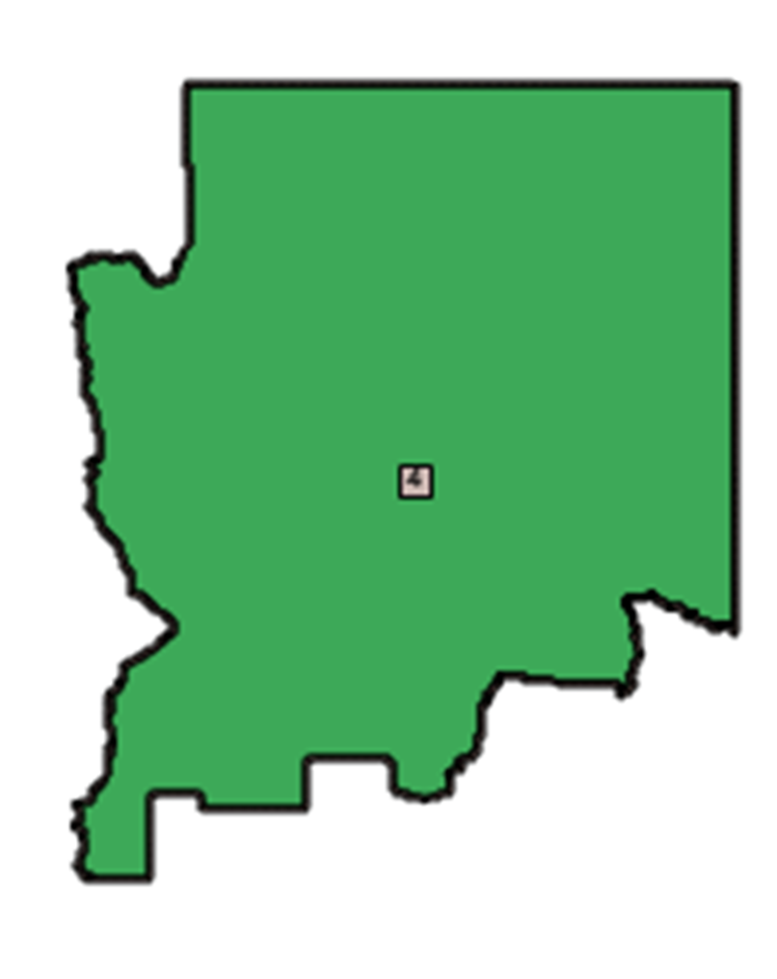
Measurements of Compactness
Population Circle Test
Grid CDs 4 is the worst
under the Population Circle Test
15

Slide 16
Measurements of Compactness
Ehrenburg Test
CD | Score
1 | .63
2 | .39
3 | .53
4 | .66
5 | .26
6 | .39
7 | .57
8 | .38
9 | .63
The Ehrenburg test computes the ratio of the largest inscribed circle divided by the area of the district. The measure is always between 0 and 1, with 1 being the most compact.
The Ehrenburg test computes one number for each district and the minimum, maximum, mean and standard deviation for the plan.
16

Slide 17
Measurements of Compactness
Ehrenburg Test
Grid CD 4 is the best
under the Ehrenburg Test
17

Slide 18
Measurements of Compactness
Ehrenburg Test
Grid CD 5 is the worst
under the Ehrenburg Test
18

